Slide 1
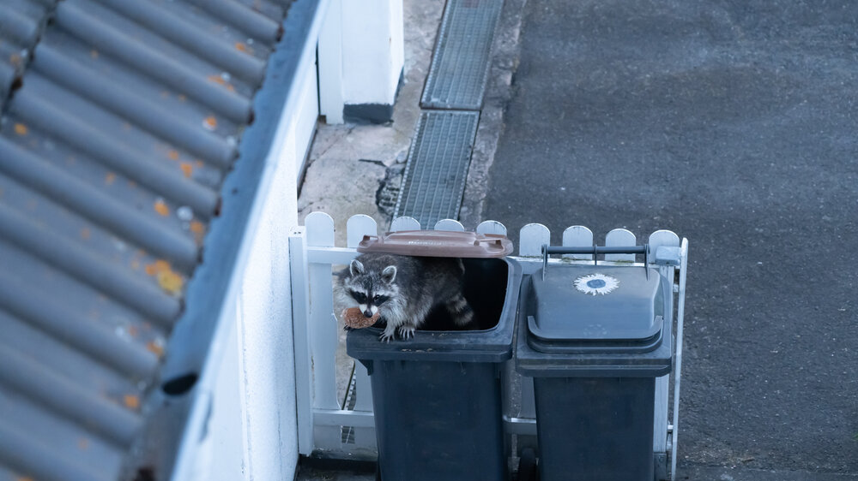
Failures in Urban Wildlife Management
Alex Urquhart, Cameron Paille, Tegan Heshka, Paige Skofteby

Slide 2
What is the purpose and tools of urban wildlife management ?
Animal removal, modification of animal behaviour (fencing, netting, repellents, scare devices) and changing human behaviour
Urban planning is the best chance at reducing negative human wildlife interactions
Conflict of space & resources

Slide 3
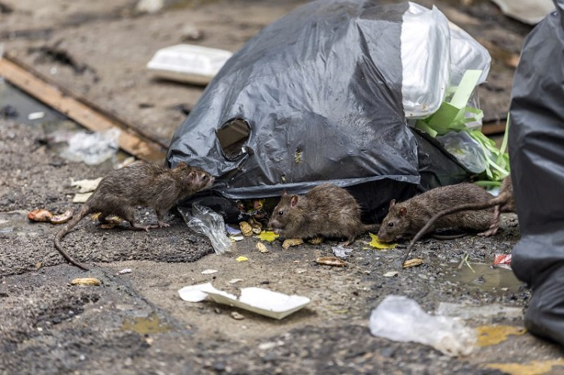
Urban Waste and Wildlife
Attractant for opportunistic species in resource scarcity
Raccoons, opossums, rats, coyotes, bears, & birds species
Consequences of urban waste for wildlife species:
Health issues
Behaviour changes
Conflict with humans
Cole M. 2024 Mar 7. Big rats continue to plague NYC’s rat mitigation zones, residents say - CBS New York. wwwcbsnewscom. https://www.cbsnews.com/newyork/news/nyc-rat-mitigation-zone-residents-react/.

Slide 4
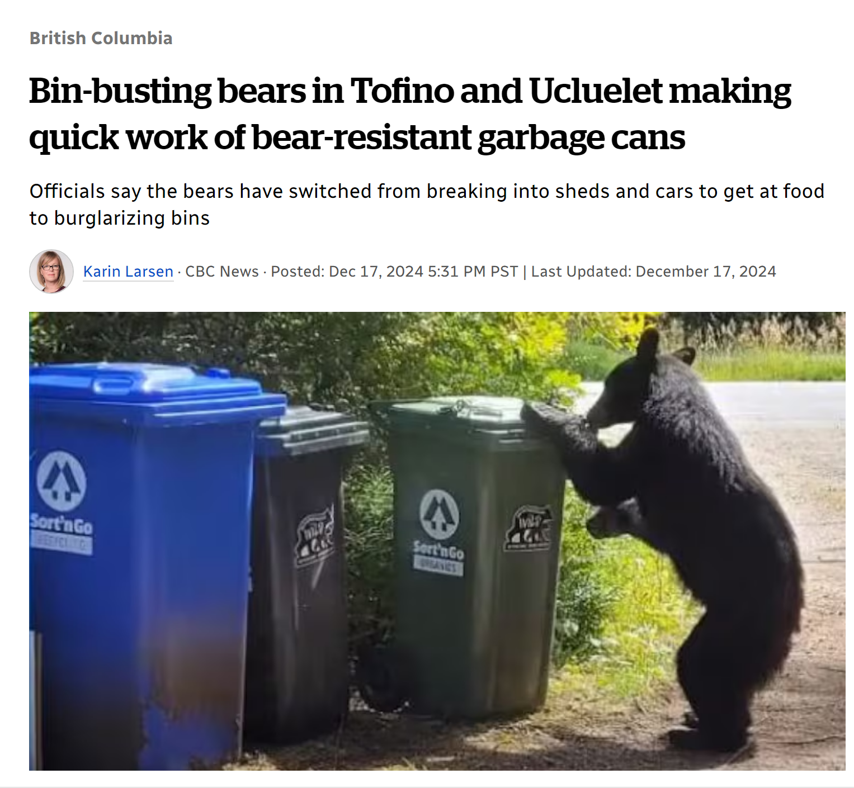
Urban Waste Management
Problems:
Waste overflow and illegal dumping
BearSmart status in British Columbia
Only held by 10 of 53 cities
Ineffectiveness of wildlife-proof garbage bins
Larsen 2024
Globally, urban waste is expected to increase by up to 70% by 2050

Slide 5
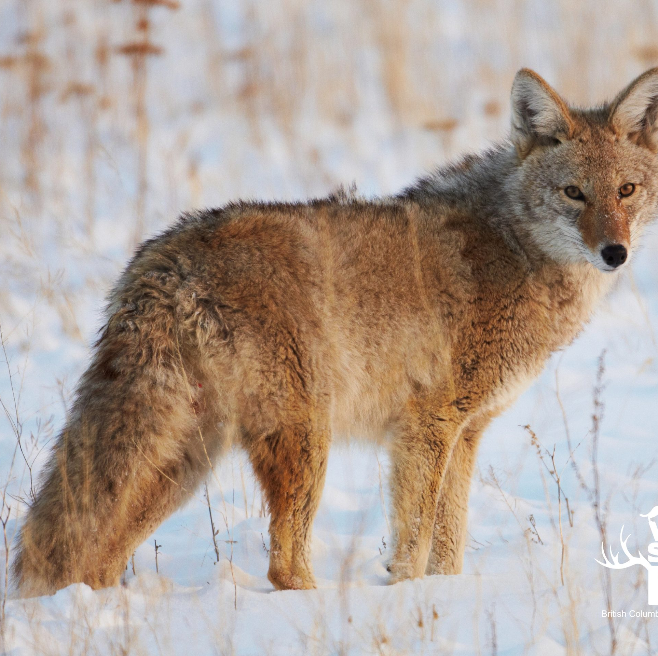
Wildlife Conflicts
Lethal control measures show no evidence of success
2023 - 27,356 calls to British Columbia Conservation Officers Service
2023 – 701 individual black bears dispatched
Risks to human health exposed
45 individuals (including children) bitten by coyotes in Stanley Park, Vancouver
Black Bear attacked
Spread of zoonotic diseases increase in conjunction with urbanization
Avian flu, rabies, ticks (Lyme’s disease),
Wildsafebc

Slide 6
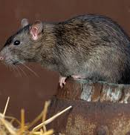
Invasive Species
Modified habitat - Modified populations
Many invasive and introduced species impact wildlife relative to urban areas
Includes Rats (R. rattus and R. norvegicus), Virginia Opossum
Cats impacting bird populations
In Canada alone, 100 million birds are killed annually by house cats
Feral cats can significantly impact bird and small vertebrate populations

Slide 7
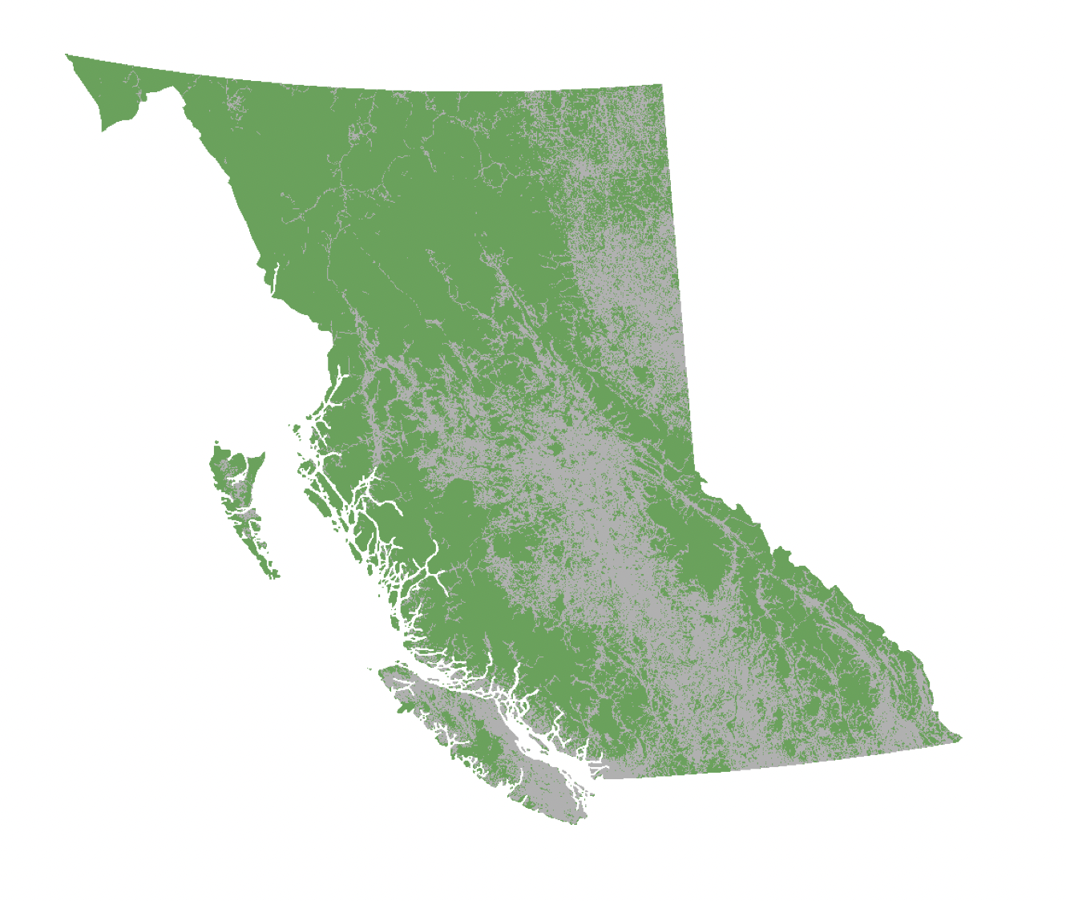
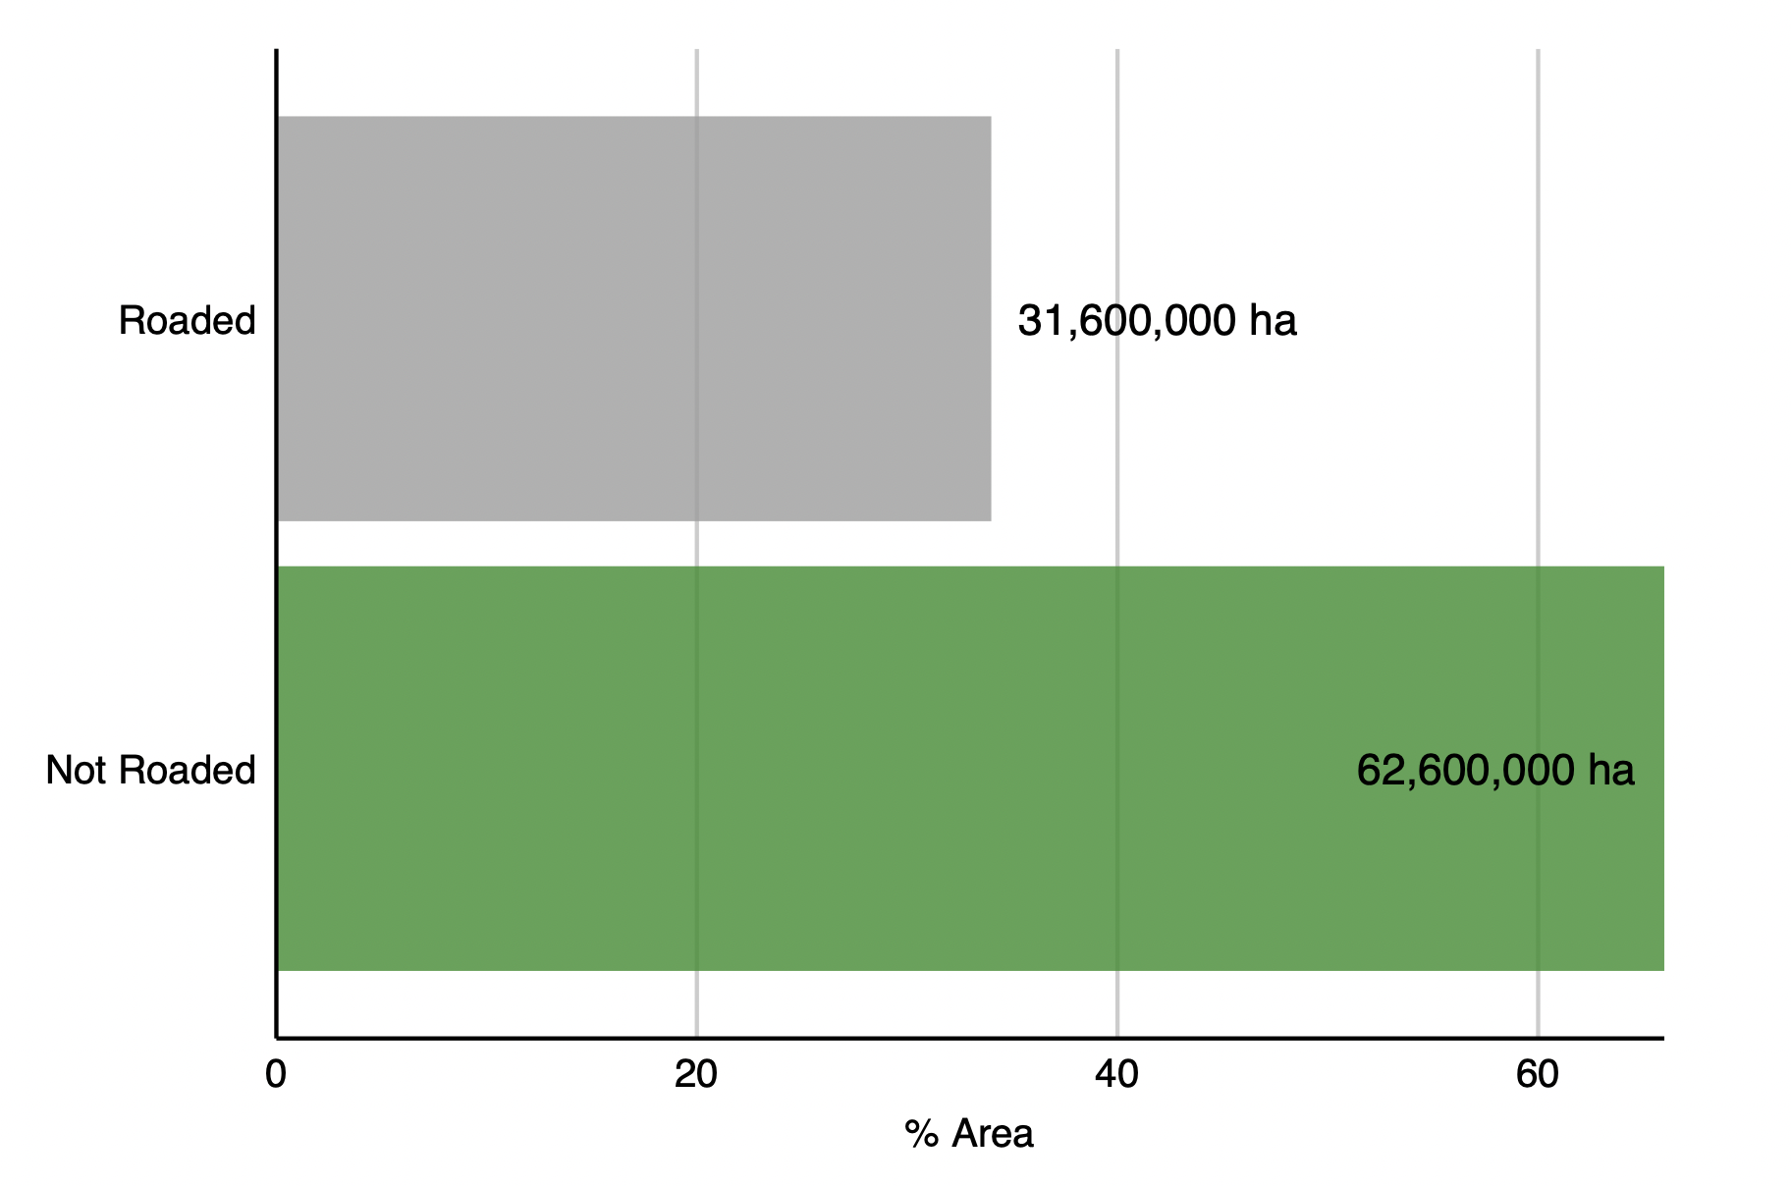
Roads and Wildlife
719,000 km of roads
~ 10,000 km add annually
Credit: Government of BC - Lands & Forests.

Slide 8
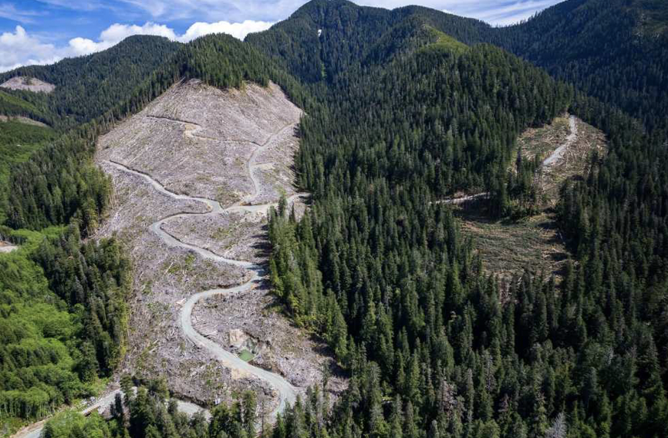
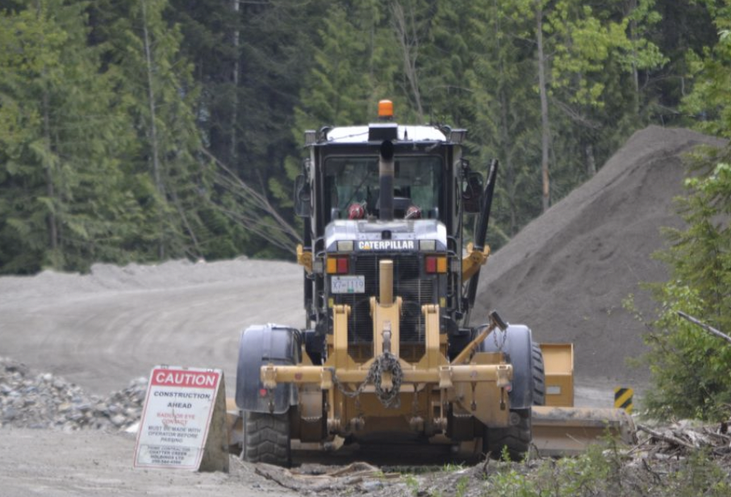
Forestry Roads
Credit: Ancientforestalliance.org
Credit: Wildernesscommittee.org
Threaten biodiversity and ecosystem health
Increase accessibility to humans and predators
Expensive, controversial solutions

Slide 9
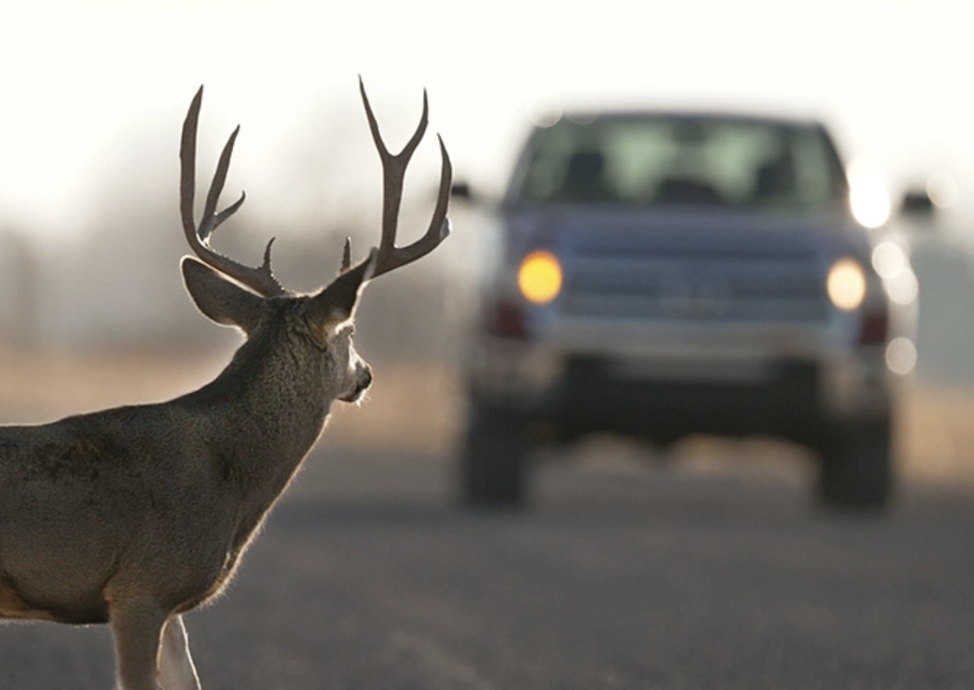
Wildlife Vehicle Collisions (WVC)
11,000 WVC reported annually in BC.
~ 6,000 occurring on BC highways.
Unreported incidents put number closer to 23,000 collisions.
Provincial estimates:
75% with deer
15% with bears, elk or moose
10% other species
Credit: Kunes, Oct 2023.

Slide 10
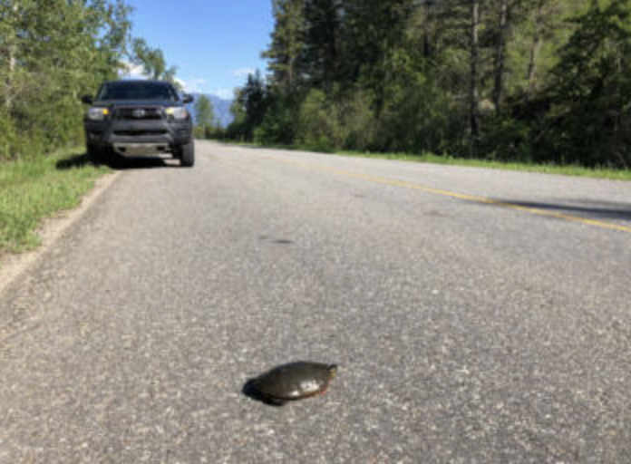
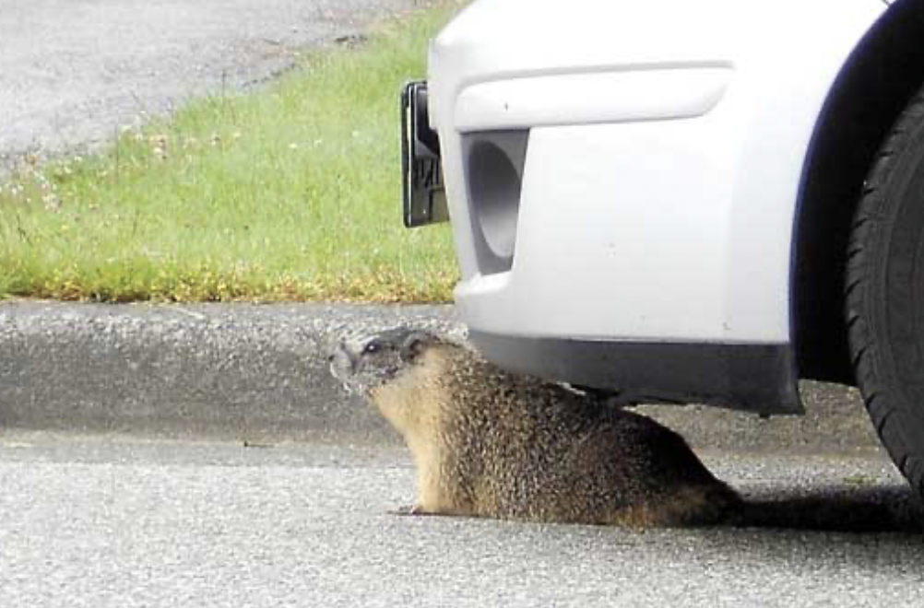
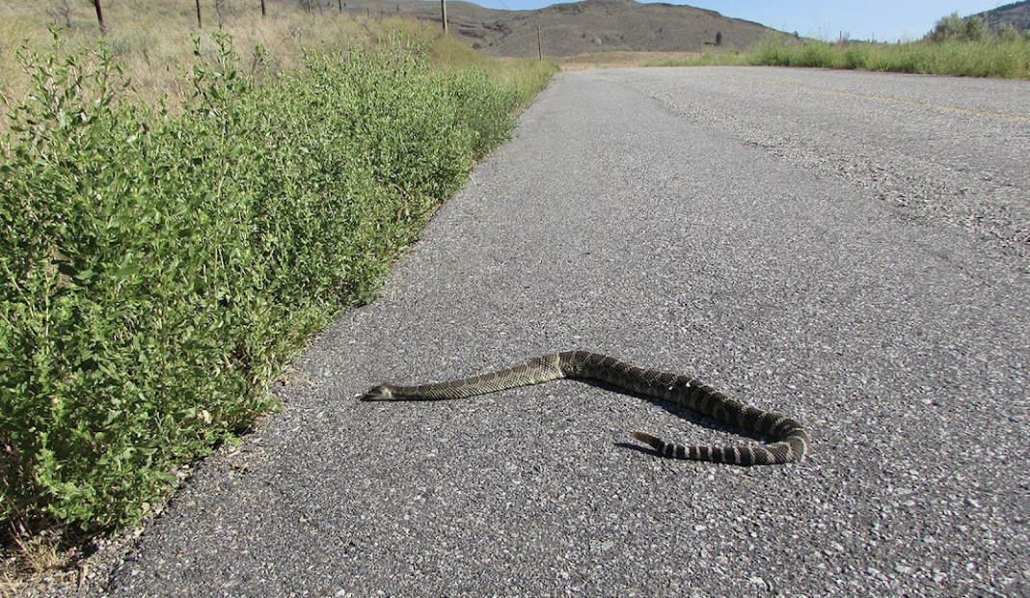
Road Mortality with Small Species
Source: Wildsight, April 2022.
Source: Burnabynow, July 2011.
Size of species highly effects rate of reporting...
Ojibway Prairie Study
Monitored surrounding roads from September to October over 10 years
Found 119 dead snakes on a single day in 2021
Total for this year was 827 dead animals
Including 490 reptiles
100 being at risk snake and turtle species.
Source: Quesnel Cariboo Observer, July 2018.

Slide 11
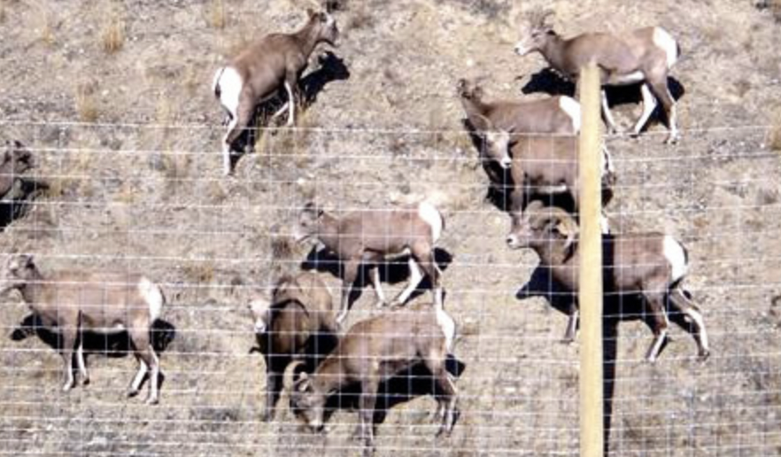
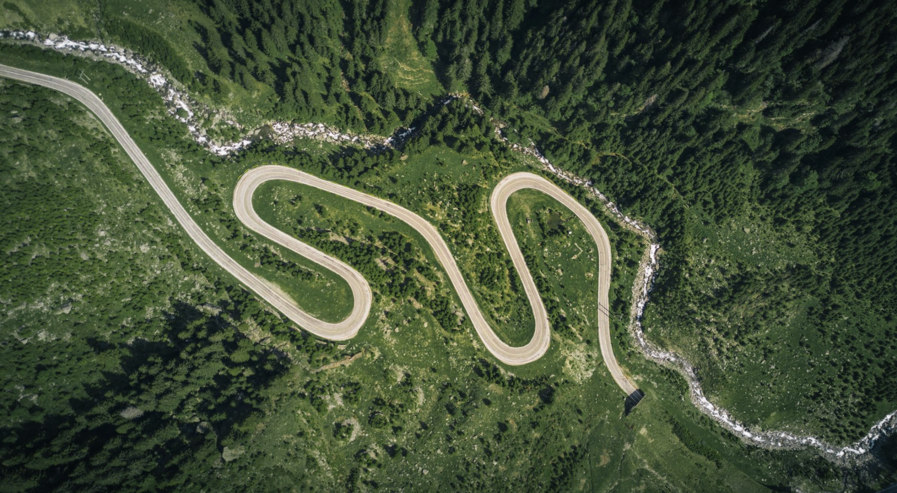
Habitat Fragmentation
Over 500 km of wildlife exclusion fencing
4 WL overpasses
29 large underpasses
More than 70 small underpasses
Source: Government of BC, January 2025.
Consequences:
Increased energetic costs from altered habitat use
Splitting populations into subpopulations
Reduced gene flow
Greater risk of mortality
Challenge of finding adequate resources and moving freely through ecosystem
Source: Nature Trust BC, March 2022.

Slide 12
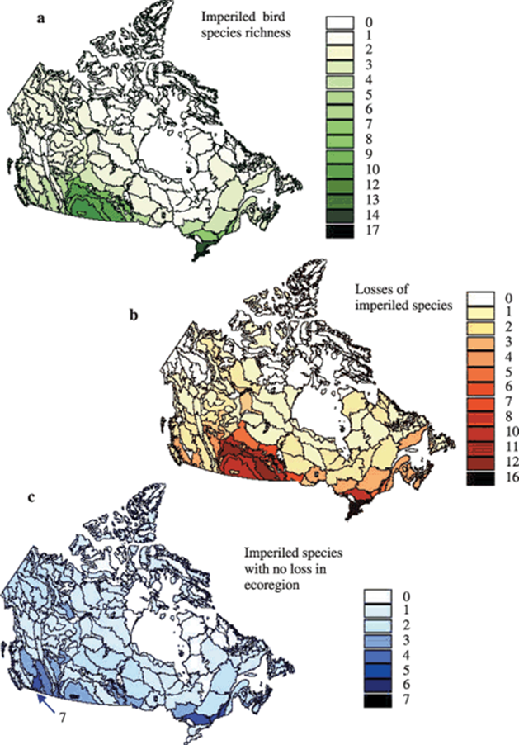
Agriculture
Land-use change is single largest threat to biodiversity (MEA 2005; Turner et al 2007)
Reliance on natural resources such as agriculture and forestry have impacted 12% of the province
Current land use planning has not prevented substantial losses to ecological values in BC (Auditor General of British Columbia 2015)
Czech el at list agriculture as the 3rd most frequent contributor to species declines (after non-native species & urbanization)
Gibbs 2009

Slide 13

References
Zepeda E, Sih A, Schell CJ, Gehrt S. 2024. Impacts of urban heterogeneity in environmental and societal characteristics on coyote survival. Urban Ecosystems. 28(1):1–12. doi:https://doi.org/10.1007/s11252-024-01643-w.
Sugden S, Sanderson D, Ford K, Stein LY, St. Clair CC. 2020. An altered microbiome in urban coyotes mediates relationships between anthropogenic diet and poor health. Scientific Reports. 10(1). doi:https://doi.org/10.1038/s41598-020-78891-1
Pawson C. 2024 Dec 28. How B.C.'s 2 biggest cities are trying to curb illegal dumping. CBC. [accessed 2025 Jan 20]. https://www.cbc.ca/news/canada/british-columbia/illegal-dumping-surrey-vancouver-1.7404092.
‌The World Bank. 2018 Sep 20. Global Waste to Grow by 70 Percent by 2050 Unless Urgent Action is Taken: World Bank Report. World Bank. https://www.worldbank.org/en/news/press-release/2018/09/20/global-waste-to-grow-by-70-percent-by-2050-unless-urgent-action-is-taken-world-bank-report.
‌The World Bank. 2018 Sep 20. Global Waste to Grow by 70 Percent by 2050 Unless Urgent Action is Taken: World Bank Report. World Bank. https://www.worldbank.org/en/news/press-release/2018/09/20/global-waste-to-grow-by-70-percent-by-2050-unless-urgent-action-is-taken-world-bank-report.
‌Strategy M of E and CC. Bear Smart - Province of British Columbia. www2govbcca. https://www2.gov.bc.ca/gov/content/environment/plants-animals-ecosystems/wildlife/human-wildlife-conflict/staying-safe-around-wildlife/bears/bear-smart.
‌Larsen K. 2024 Dec 18. Bin-busting bears in Tofino and Ucluelet making quick work of bear-resistant garbage cans. CBC. [accessed 2025 Jan 20]. https://www.cbc.ca/news/canada/british-columbia/bears-outsmart-smart-garbage-cans-1.7412766.
‌Chung E. 2021 Mar 10. Urban coyotes are literally full of garbage — and that’s risky for humans, study suggests. CBC. https://www.cbc.ca/news/science/coyote-diet-1.5942641.
Adams LW, VanDruff LW, Maciej Luniak. 2005 Jan. Managing urban habitats and wildlife. Research Gate.:714–739. [accessed 2025 Jan 19]. https://www.researchgate.net/publication/261834561_Managing_urban_habitats_and_wildlife.
Beyond Pesticides. 2019. Impacts of Pesticides on Wildlife. Beyond Pesticides. [accessed 2025 Jan 19]. https://www.beyondpesticides.org/programs/wildlife.
Gibbs KE, Mackey RL, Currie DJ. 2009. Human land use, agriculture, pesticides and losses of imperiled species. Diversity and Distributions. 15(2):242–253. doi:https://doi.org/10.1111/j.1472-4642.2008.00543.x.
Ministry of Agriculture. 2014. Farm Practices Interior BC -Wildlife Damage Control FARM PRACTICE INTERIOR BC WILDLIFE DAMAGE CONTROL Description. [accessed 2025 Jan 17]. https://www2.gov.bc.ca/assets/gov/farming-natural-resources-and-industry/agriculture-and-seafood/agricultural-land-and-environment/strengthening-farming/farm-practices/870218-60_wildlife_damage_interior_bc.pdf.
Shackelford N, Standish RJ, Ripple W, Starzomski BM. 2018. Threats to biodiversity from cumulative human impacts in one of North America’s last wildlife frontiers. Conservation Biology. 32(3):672–684. doi:https://doi.org/10.1111/cobi.13036.
Wildsafebc, 2025. Coyote-Human Interactions in Urban Areas . https://wildsafebc.com/species/coyote/
Cole M. 2024 Mar 7. Big rats continue to plague NYC’s rat mitigation zones, residents say - CBS New York. wwwcbsnewscom. https://www.cbsnews.com/newyork/news/nyc-rat-mitigation-zone-residents-react/.
Government of BC. September 2024. Threats to Ecosystems and Biodiversity. https://www2.gov.bc.ca/gov/content/environment/plants-animals-ecosystems/biodiversity/threats#loss-of-habitat-and-fragmentation
Spruyt, J. 2018. Effectiveness of Road Mortality Mitigation In A Northern Community of Snakes. Thompson Rivers University Master Thesis. https://www.tru.ca/__shared/assets/Spruyt_Thesis59947.pdf
Wildlife Preservation Canada. January 2022. 2021 saw record high mortality on roads surrounding Windsor Nature Preserve. https://wildlifepreservation.ca/blog/2021-saw-record-high-mortality-on-roads-surrounding-windsor-nature-preserve/
Wildlife Collision Prevention Program. ND. Collision Facts. [Accessed 2025 January 14th] https://www.wildlifecollisions.ca/collision/collision-facts.htm
Hunters for BC. ND. Resource Road Density in BC - A Discussion Paper on Issues and Solutions. [Accessed 2025 January 14th]. https://huntersforbc.ca/resource-road-density-in-bc-a-discussion-paper-on-issues-and-solutions/#:~:text=The%20amount%20of%20resource%20roads%20in%20BC%20and%20the%20problems,roads%20are%20constructed%20every%20year.
Environmental Reporting BC. May 2018. Roads & Roadless Areas in British Columbia. https://www.env.gov.bc.ca/soe/indicators/land/roads.html#:~:text=While%20roads%20serve%20the%20interests,varies%20considerably%20across%20British%20Columbia.
Government of BC. January 2025. Wildlife Management on B.C. Highways. https://www2.gov.bc.ca/gov/content/transportation/transportation-infrastructure/engineering-standards-guidelines/environmental-management/wildlife-management
Wilderness Committee. 2024. New logging road network shows BC is failing at-risk species and habitats. https://www.wildernesscommittee.org/news/new-logging-road-network-shows-bc-failing-risk-species-and-habitats

