Slide 1
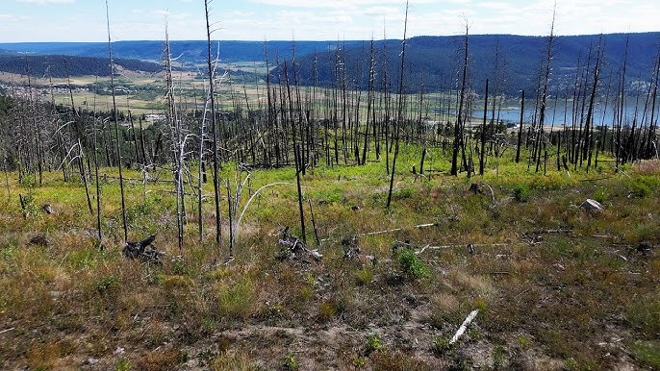
A decade of change:
Assessing the changes in plant community composition following a post-fire seeding treatment
By Paige Skofteby

Slide 2
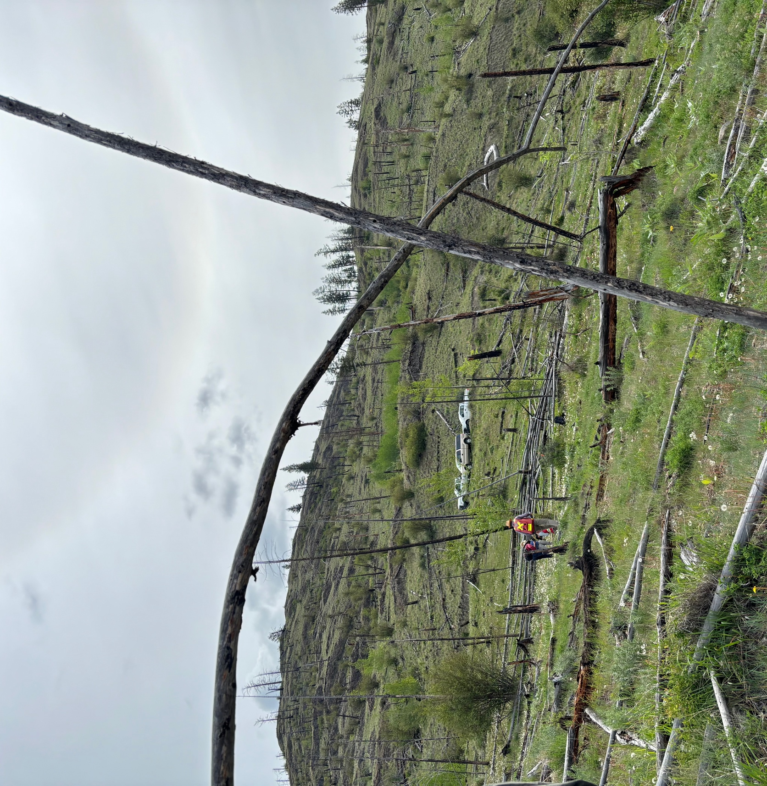
Overview
Background
Study Objectives
Site Description
Strawberry Hill Wildfire
Data Collection
Statistical Analysis
Results
Key Findings
Study Limitations
Questions

Slide 3
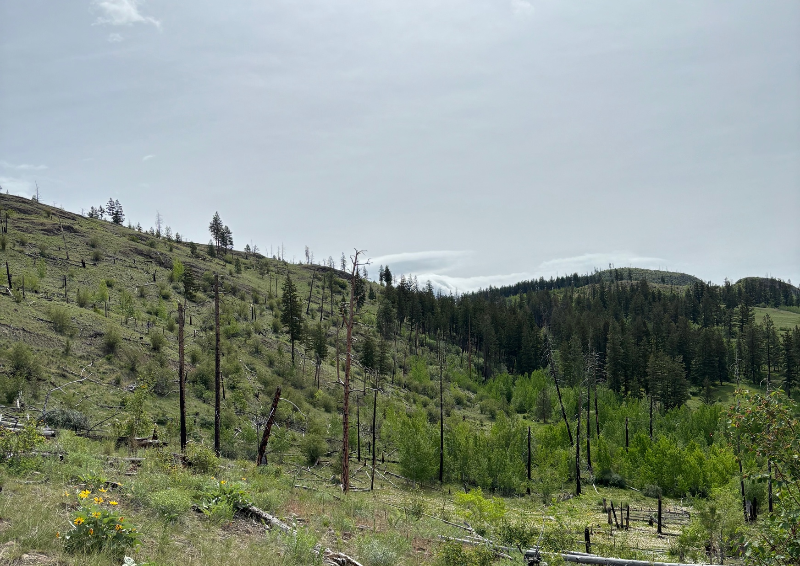
Seeding for Restoration
Protect human health and property
Reduce the risk of soil erosion and watershed degradation
Restore native plant communities and biodiversity
Prevent invasive species establishment
Increase grazing forage
Improve wildlife habitat

Slide 4
Long-term monitoring
Land-use changes over the last century has reduce resiliency of ecosystems
Amplified intensity and severity has increased management inputs post-disturbance
Aggressive, non-native species commonly used
Large seed production
Rapid water extraction
Interference with native species regeneration and establishment
Limited knowledge on long-term impacts

Slide 5
Study Objectives
Analyze changes in plant community composition since 2014
Assess whether seeding has successfully suppressed invasive species establishment
Evaluate whether the seeding treatment has facilitated the recovery of native plant species

Slide 6
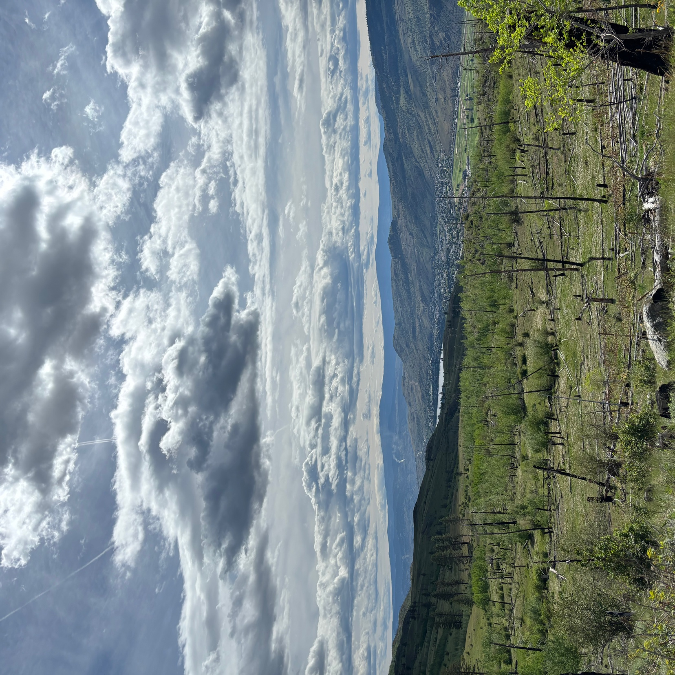
Site Description
IDFxh2
Elevation ranges between 650 – 750 m
Average slope of 31%
Grazing
650-ha cattle pasture of the Seven-O Ranch grazing lease
No grazing for two years after treatment
Currently 1500 AUMs

Slide 7
Original Plant Community
70% coniferous forest
Douglas fir
Ponderosa pine
30% grassland
Bluebunch wheatgrass
Needle-and-thread grass
Mix of grassland forbs
Invasive species
Canada thistle
Spotted knapweed
Plumeless thistle
Dalmation toadflax

Slide 8
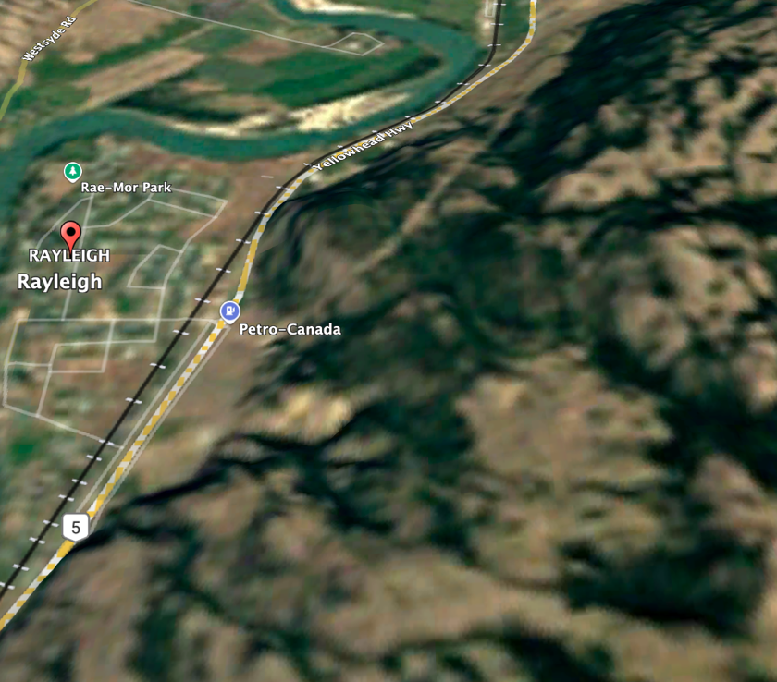
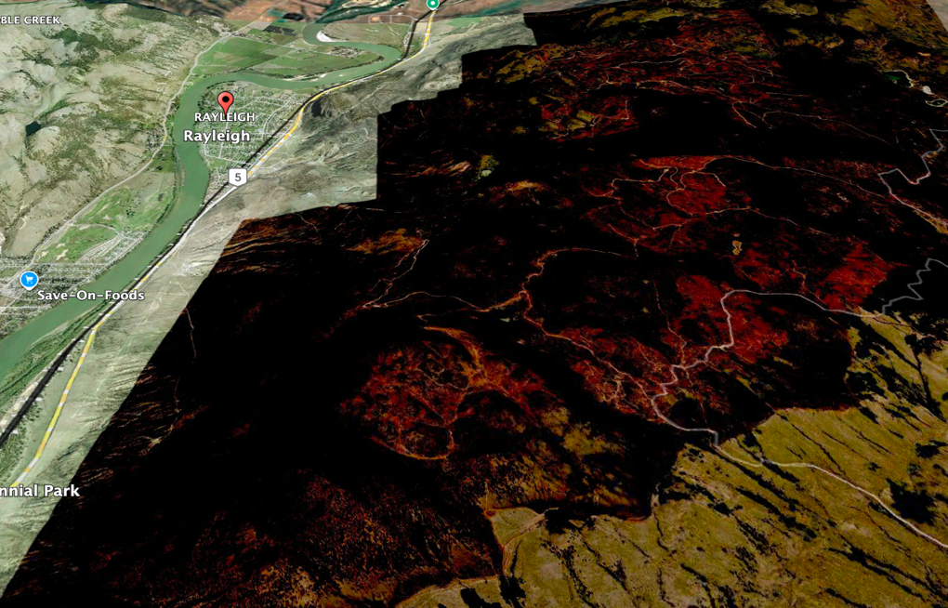
Strawberry Hill Wildfire (K20298)
2024
Began on August 1, 2003
Burnt 5,731 hectares
Complete mortality
Moderate - high soil burn severity
Assessment for plant survival 11 months after fire
2003
2004

Slide 9
Seeding Treatment
Species | % by weight | % by density | Seeds/kg | Seeds/m2
Italian ryegrass | 32 | 22 | 501,000 | 80
Creeping red fescue | 5 | 8 | 1,068,380 | 27
Canada bluegrass | 4 | 31 | 5,511,500 | 110
Timothy | 4 | 15 | 2,712,000 | 54
Western wheatgrass | 35 | 12 | 243,000 | 43
Rambler alfalfa | 20 | 12 | 441,000 | 44
Aerially dispersed by helicopter
Spread over 250m x 50m plots
289,000 seeds/ha

Slide 10
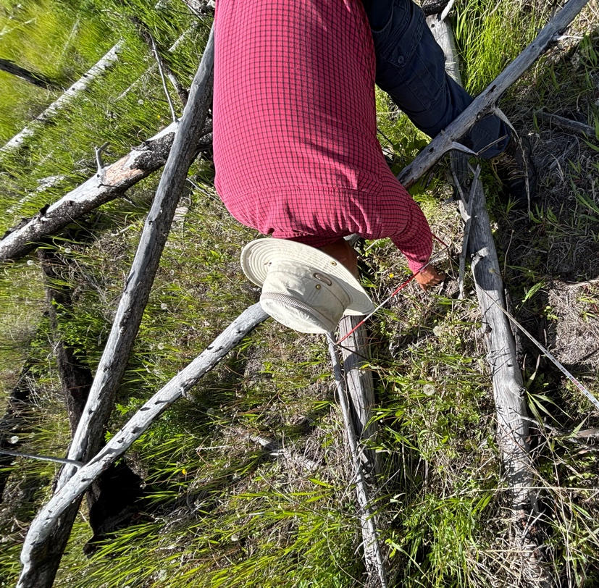
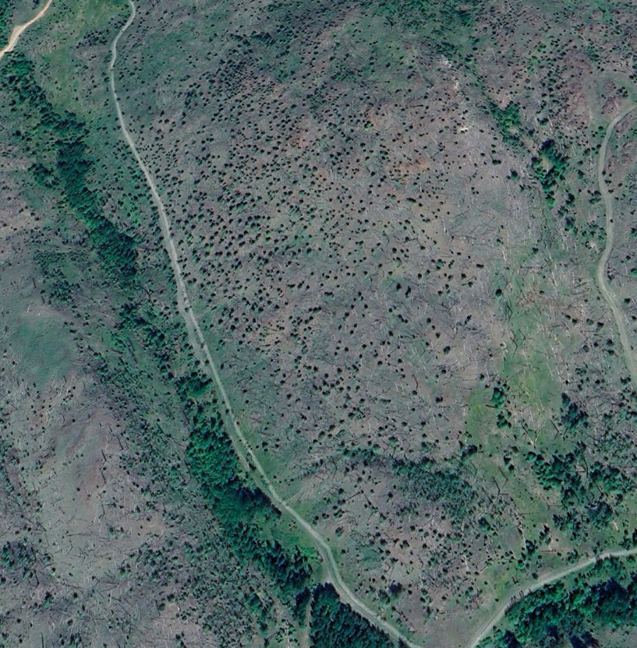
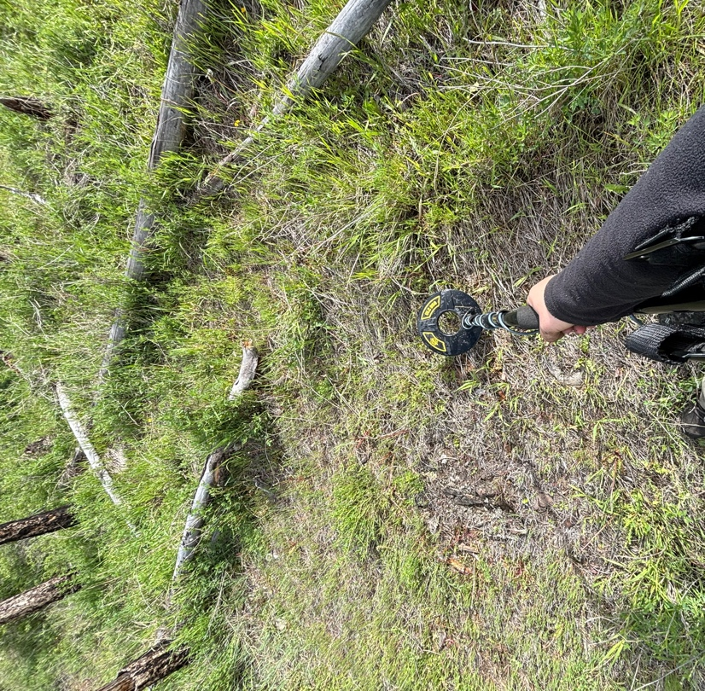
Data Collection
Permanent metal stakes
Five 50 m transect lines in each treatment plot
Vascular plant species identified using canopy cover method
20 cm x 50 cm quadrants

Slide 11
Data Analysis
Two-way ANOVA used to test for mean cover differences
Simpson’s diversity index to assess dominance
Shannon’s diversity index to identify species richness
Histograms for visual representation

Slide 12
ANOVA Results
Origin | Mean Cover Control |  | Mean Cover Treatment |  | P value
 | 2014 | 2024 | 2014 | 2024
Native | 3.05 | 1.88 | 1.28 | 0.57 | 0.0119
Exotic | 5.41 | 6.54 | 5.95 | 9.53 | 0.554
Diversity Indices
Diversity Index | Control Mean | Treatment Mean | P value
Shannon’s | 3.23 | 2.82 | 0.05929
Simpson’s | 0.935 | 0.921 | 0.2422

Slide 13
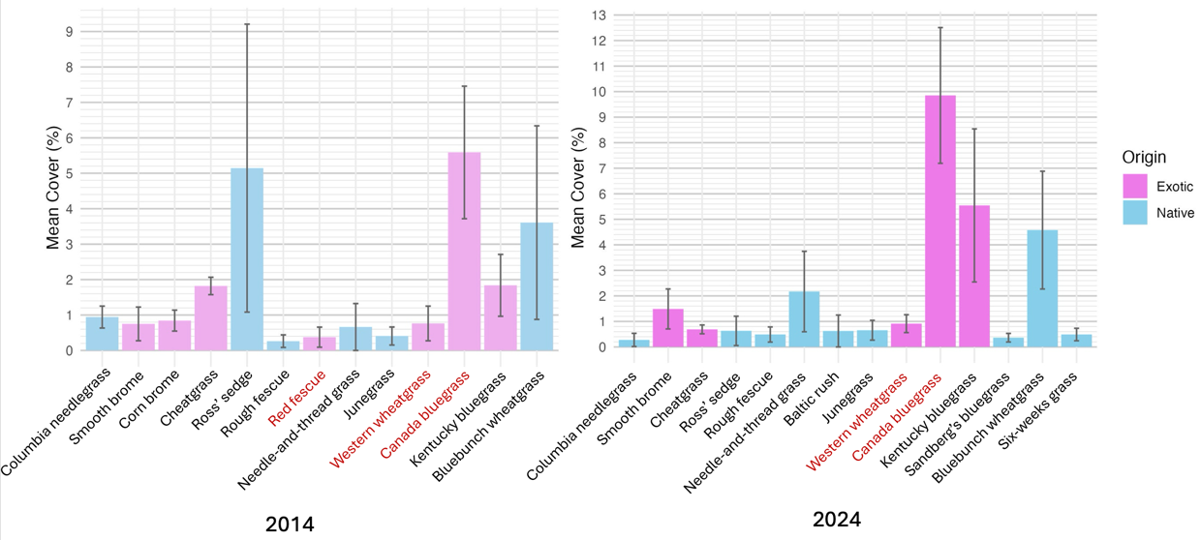
Grass community changes in the unseeded plots

Slide 14
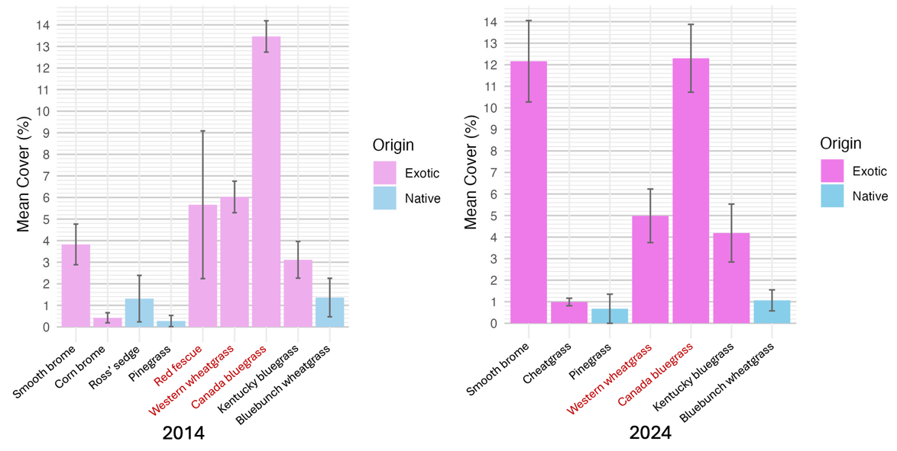
Grass community changes in the seeded plots

Slide 15
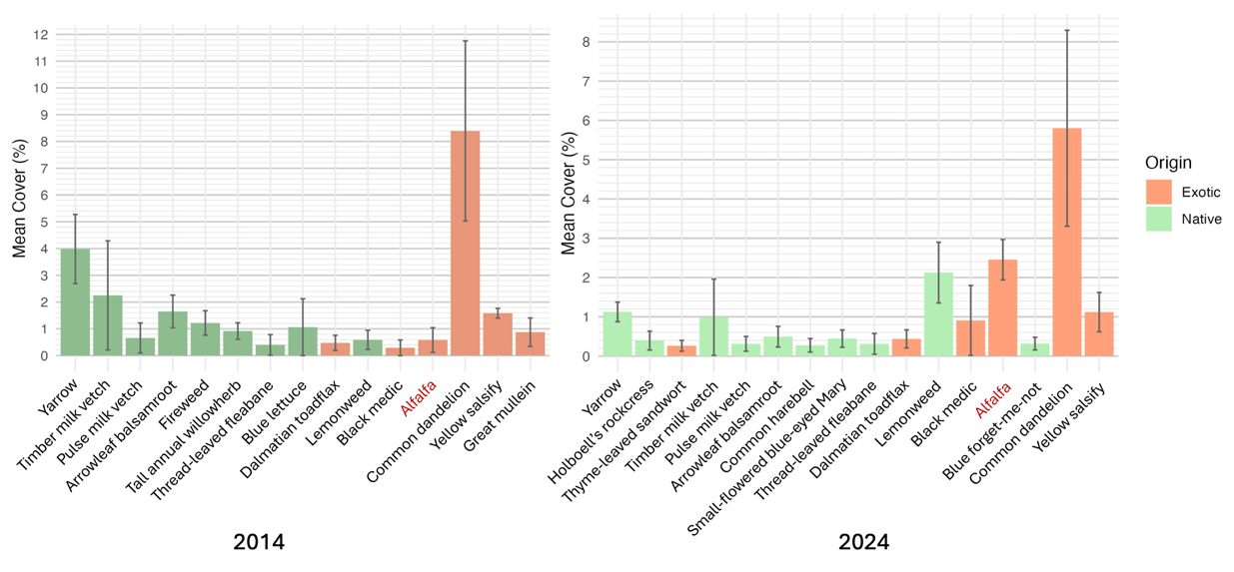
Forb community changes in unseeded plots

Slide 16
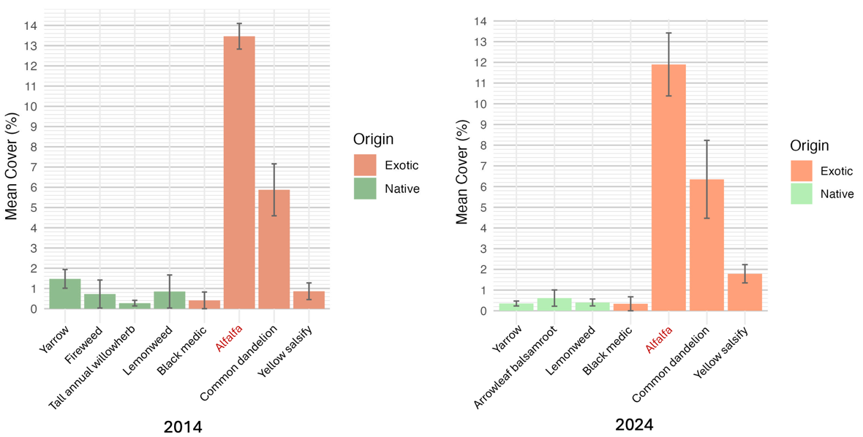
Forb community changes in seeded plots

Slide 17
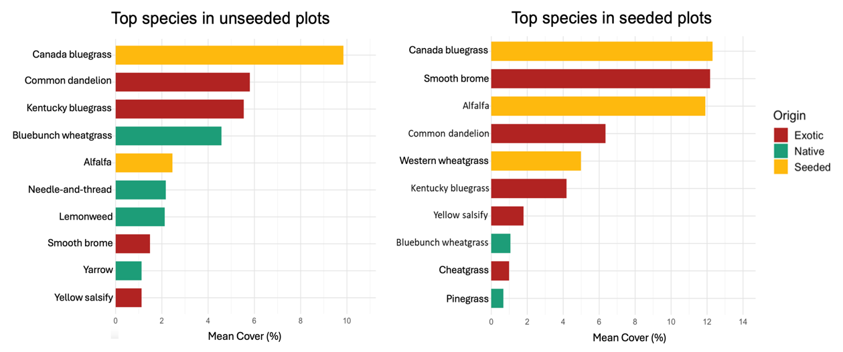
Comparison of the current top species between treatment plots

Slide 18
Key Findings
Evident changes have occurred within treatment plots
Clear patterns emerging between treatments
The seed mixture has not inhibited invasive species from establishing
The seed mixture has increased competition occurring within plots, greatly impacting native species regeneration

Slide 19
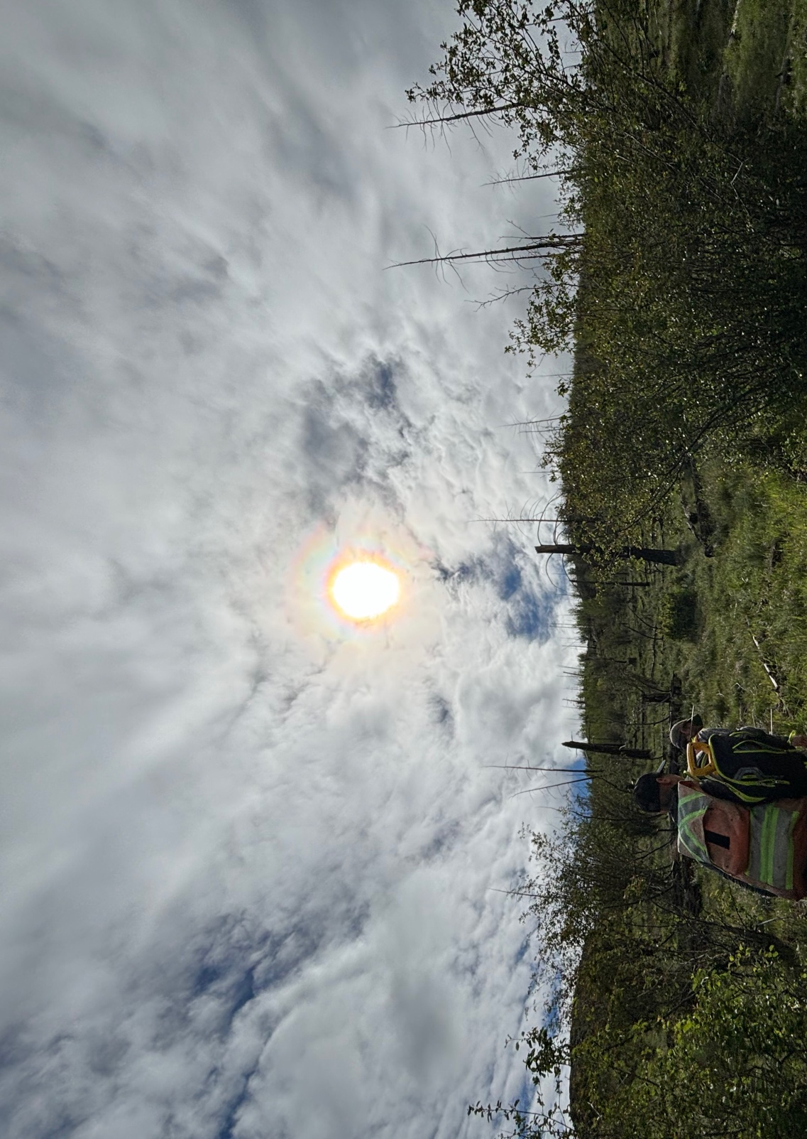
Study Limitations
Contaminants in seed mixture
Proximity of plots
Aerial drift
Selective grazing

Slide 20
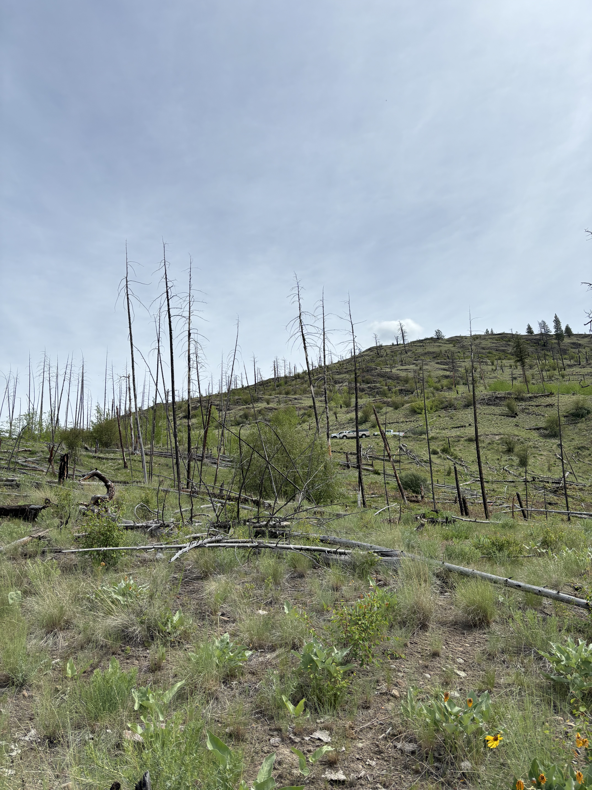
Questions?
Acknowledgements

